Slide 1

TITLE : CLASSIFICATION OF CHRONIC KIDNEY DISEASE - USING MACHINE LEARNING
UNIVERSITY COLLEGE OF ENGINEERING (BIT CAMPUS), TIRUCHIRAPPALLI
GUIDED BY
MRS. S. CHITRA DEVI
DEPARTMENT OF CSE
UCE –BIT CAMPUS
TIRUCHIRAPPALLI
SUBMITTED BY
RAMYA S (810022205094)
VINODHINI K (810022205069)

Slide 2
INTRODUCTION
Chronic Kidney Disease (CKD) is a serious health condition that often remains undetected in its early stages
Affects over 850 million people worldwide
Early diagnosis is essential to prevent disease progression and complications
This project proposes a Machine Learning–Based CKD Prediction System that analyzes patient clinical data to predict the presence of CKD
By applying machine learning algorithms such as ANN, Decision Tree, Logistic Regression, KNN, SVM, and Random Tree, the system provides accurate and timely predictions
The proposed solution aims to support healthcare professionals with a cost-effective and reliable decision-support tool for early CKD detection

Slide 3
ABSTRACT
Chronic Kidney Disease (CKD) is a serious health condition that often remains undetected in its early stages.
Early diagnosis is essential to prevent disease progression and complications.
This project proposes a Machine Learning–Based CKD Classification System that analyzes patient clinical data to predict the presence of CKD.
By applying machine learning algorithms such as Decision Tree, Random Forest, Naive Bayes, Logistic Regression, KNN, and Support Vector Machine(SVM) the system provides accurate and timely predictions.
The proposed solution aims to support healthcare professionals with a cost-effective and reliable decision-support tool for early CKD detection.

Slide 4
OBJECTIVE
To identify early signs of kidney disease using patient medical data
To help doctors make faster decisions by giving prediction results automatically
To reduce manual errors in diagnosis using machine learning
To apply feature selection methods to find the most important health attributes
To compare multiple algorithms and identify the best one for CKD prediction
To improve healthcare support using technology

Slide 5
PROBLEM STATEMENT
Diagnosing CKD manually requires specialist doctors and expensive laboratory tests — not accessible to all
Rural and low-income areas lack access to nephrologists, leading to late-stage diagnosis
Existing systems use all medical attributes without filtering, which leads to lower accuracy and slower predictions
There is no comprehensive system that compares multiple feature selection methods and classification algorithms together
A need exists for an automated, accurate, and early CKD prediction system that is easy to use

Slide 6
ARCHITECTURAL DESIGN FOR PROPOSED SYSTEM
DATA SOURCE
DATA PROCESSING
FEATURE SELECTION
CLASSIFICATION LAYER
UCI & Kaggle
(CSV File Data)
Cleaning
(Missing values)
FILTER FS
CKD / Non-CKD
Real-time Metrics(Accuracy, Precision, Recall, F- Measure)
WRAPPER FS
Normalization
Patient Attributes
(Age, Bp, Sugar)
EMBEDDED FS
Remove Irrelevant Data
Algorithms
NB, DT, LR,KNN, RT, ANN,SVM
MODEL REGISTRY
DEPLOYMENT LAYER
Real-time Usage Streamlit App

Slide 7
DATA FLOW DIAGRAM
USER/DOCTOR
Data Collection
Preprocessing
Feature Selection
Classification
Result
USER/DOCTOR

Slide 8
TECHNOLOGIES & MACHINE LEARNING MODELS
Frontend & Backend:
Java – NetBeans (Java with NetBeans is used to develop both the frontend interface and backend logic of the system)
GUI Components Used:
JFrame – Main application window
JButton – Load Dataset, Feature Selection, Classification
JTextArea– Displays dataset and results
JPanel, JScrollPane – Layout and scrolling
Machine Learning Library:
Weka 3.7.11 – Provides all ML algorithms and feature selection methods
Chart Library:
JFreeChart – Generates professional bar charts for visual comparison of algorithm performance
Dataset Format:
CSV (kidney1.csv) – Stores patient medical records

Slide 9
PERFORMANCE METRICES
Accuracy
Formula: (Correct Predictions / Total Patients) × 100
Meaning: Overall percentage of correct diagnoses
Precision
Formula: TP / (TP + FP) × 100
Meaning: Of patients predicted CKD, how many truly have CKD
Recall (Sensitivity)
Formula: TP / (TP + FN) × 100
Meaning: Of actual CKD patients, how many were correctly identified
F-Measure
Formula: 2 × (Precision × Recall) / (Precision + Recall)
Meaning: Balance between Precision and Recall
Confusion Matrix:
TP (correct) | FN (missed — dangerous!)
FP (alarm) | TN (correct)

Slide 10
LITERATURE SURVEY
YEAR | AUTHOR | TITLE | ADVANTAGES | LIMITATIONS
2025 | MD SADI AL HUDA | An Explainable and Real-Time Framework for Predicting Chronic Kidney Disease | Achieved high accuracy with transparent predictions | Deployment depends on data quality and system integration
2022 | YAWEN ZHAO | A Chronic Kidney Disease Diagnostic Model Based on an Interpretable Deep Belief Rule Base | High diagnostic accuracy with improved interpretability | Model complexity increases with rule generation
2021 | PANKAJ CHITTORA | Prediction of Chronic Kidney Disease – A Machine Learning Perspective | DNN achieved 99.6% accuracy LSVM-L2 achieved 98.86% | High computational cost Limited real-time applicability
2021 | LINTA ANTONY | A Comprehensive Unsupervised Framework for Chronic Kidney Disease Prediction | Achieves very high accuracy (up to 99.3%) using K-means clustering improving prediction performance | Performance is dataset-dependent K-means clustering is sensitive to initial centroid selection
2020 | GUOZHEN CHEN | Prediction of Chronic Kidney Disease Using Adaptive Hybridized Deep Convolutional Neural Network on the Internet of Medical Things Platform | High accuracy using AHDCNN, effective feature extraction from medical images, suitable for real-time IoMT healthcare systems | High computational cost, requires large labeled datasets

Slide 11
LITERATURE SURVEY
YEAR | AUTHOR | TITLE | ADVANTAGES | LIMITATIONS
2020 | JIONGMING QIN | A Machine Learning Methodology for Diagnosing Chronic Kidney Disease | Uses KNN imputation to handle missing values effectively Integrated model improves accuracy Achieves very high diagnostic accuracy | Model complexity increases due to ensemble approach Not designed for real-time deployment
2020 | ERIK ALONSO | A Machine Learning Framework for Pulse Detection During Out-of-Hospital Cardiac Arrest | Uses a novel feature extraction method combining ECG and TI signals, improving detection performance. | Machine learning models may require retraining for different patient populations
2019 | KALLENBERGER & SCHMIDT | Forecasting the Development of Acute Kidney Injury Using a Recurrent Neural Network | Early prediction capability, handles sequential clinical data | High false-positive rate, limited accuracy
2018 | MUHAMED ALI | A Machine Learning Approach for the Classification of Kidney Cancer Subtypes Using miRNA Genome Data | High classification accuracy (~95%) Effective feature selection using NCA | Limited to genomic data, not suitable for general CKD datasets

Slide 12
FEATURE SELECTION METHODS
Filter Method
Method: CfsSubsetEval + GreedyStepwise
Selects features based on correlation with class label
Example:
From (Age, BP, BP2, Sugar) → removes BP2 (duplicate of BP)
Keeps only: sc, hemo, al, bp, sg, htn
Wrapper Method
Method: WrapperSubsetEval + Random Tree
Tests feature subsets using a classifier
Example:
Tries (Age, BP), (BP, Sugar), (Age, Sugar)
Selects (BP, Sugar) because it gives highest accuracy
Embedded Method
Method: SymmetricalUncertAttributeEval + Ranker
Ranks features using information score (threshold = 0.2)
Example:
Ranks = Sc (1st), Hemo (2nd), BP (3rd)
Selects top features: Sc, Hemo, BP, Al, Htn, Dm

Slide 13
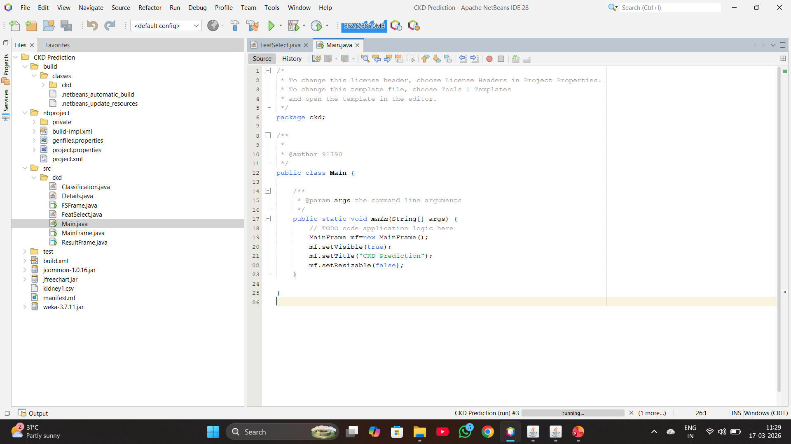
IMPLEMENTATIONS

Slide 14
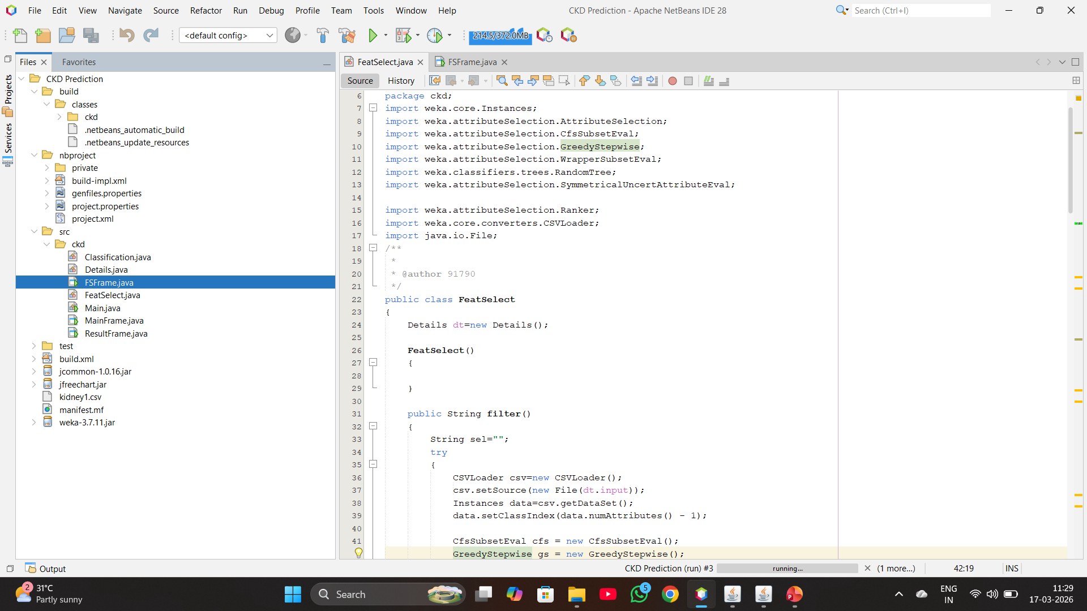
IMPLEMENTATIONS

Slide 15
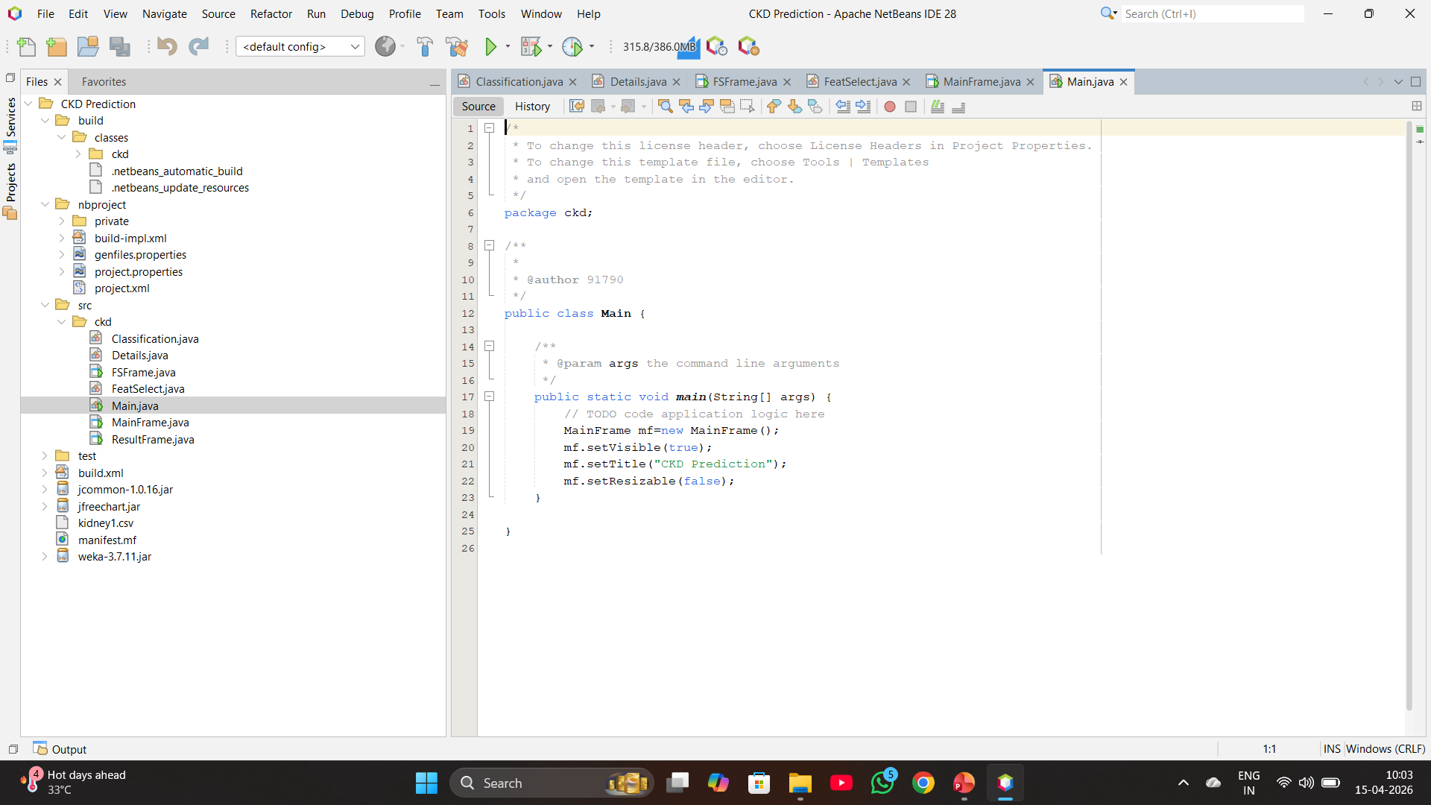
IMPLEMENTATIONS

Slide 16
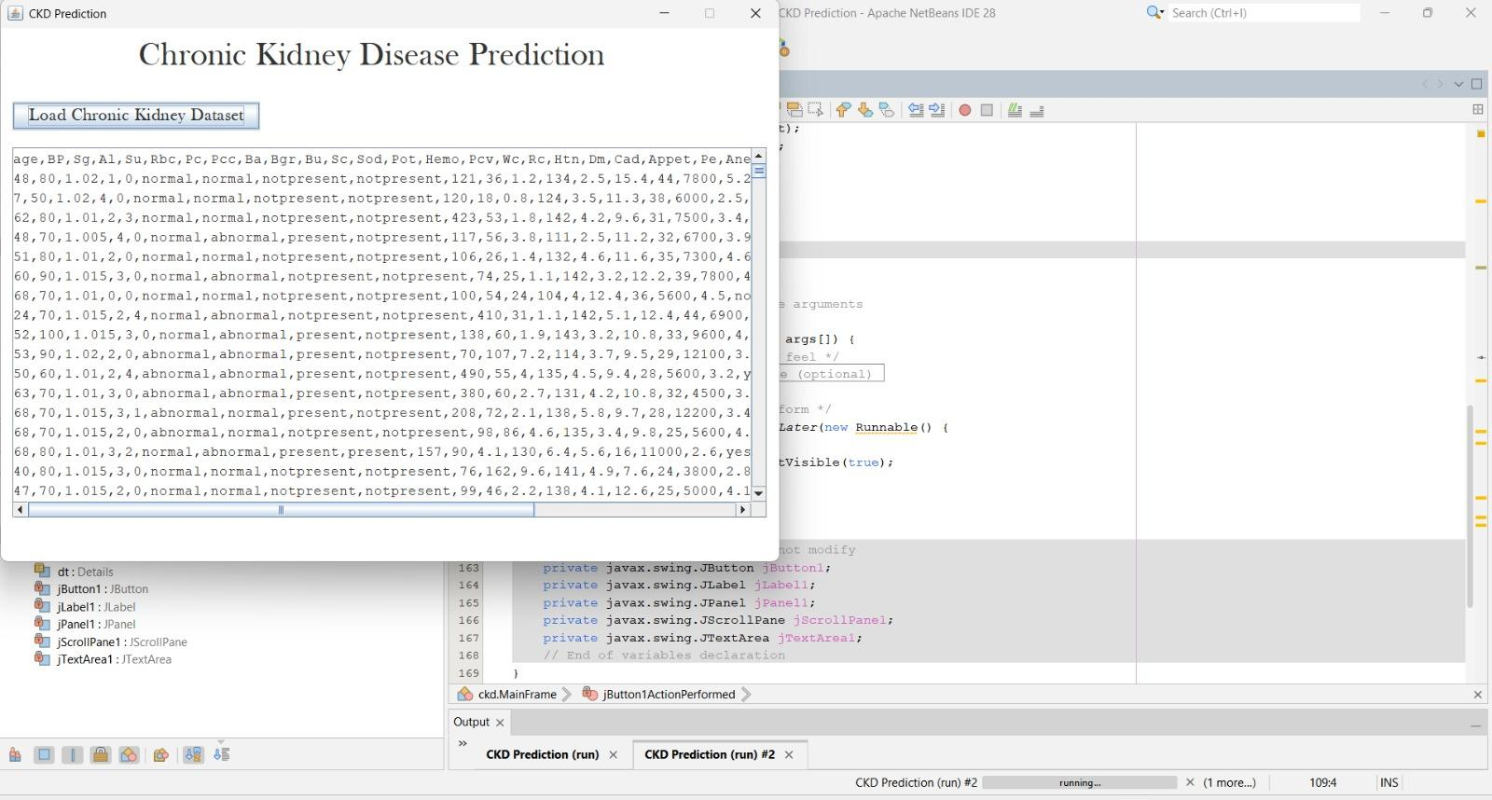
DATASET LOADING SCREEN

Slide 17
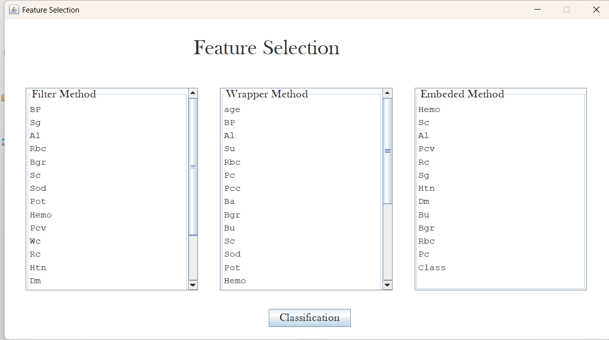
CLASSIFICATION OF FEATURE SELECTION

Slide 18
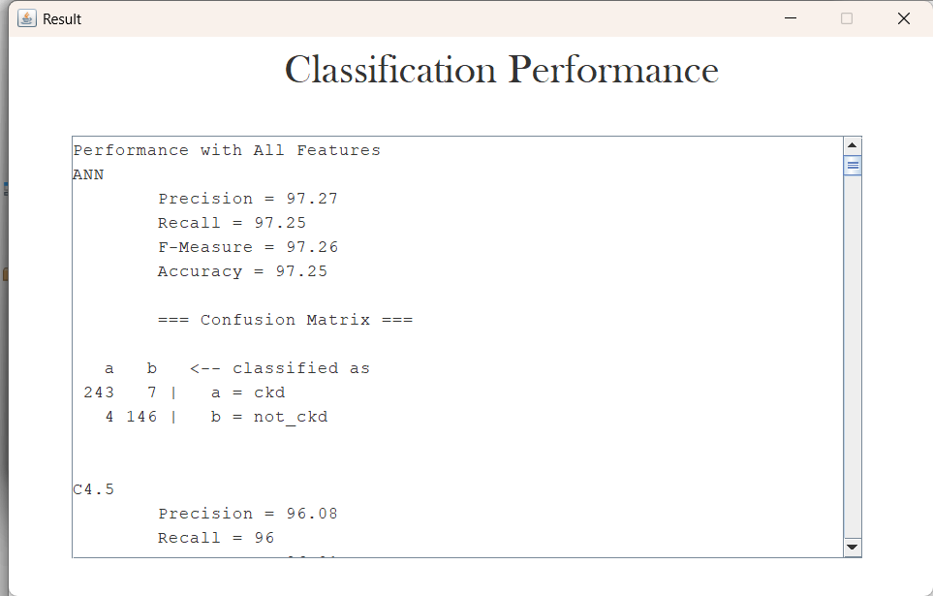
RESULT

Slide 19
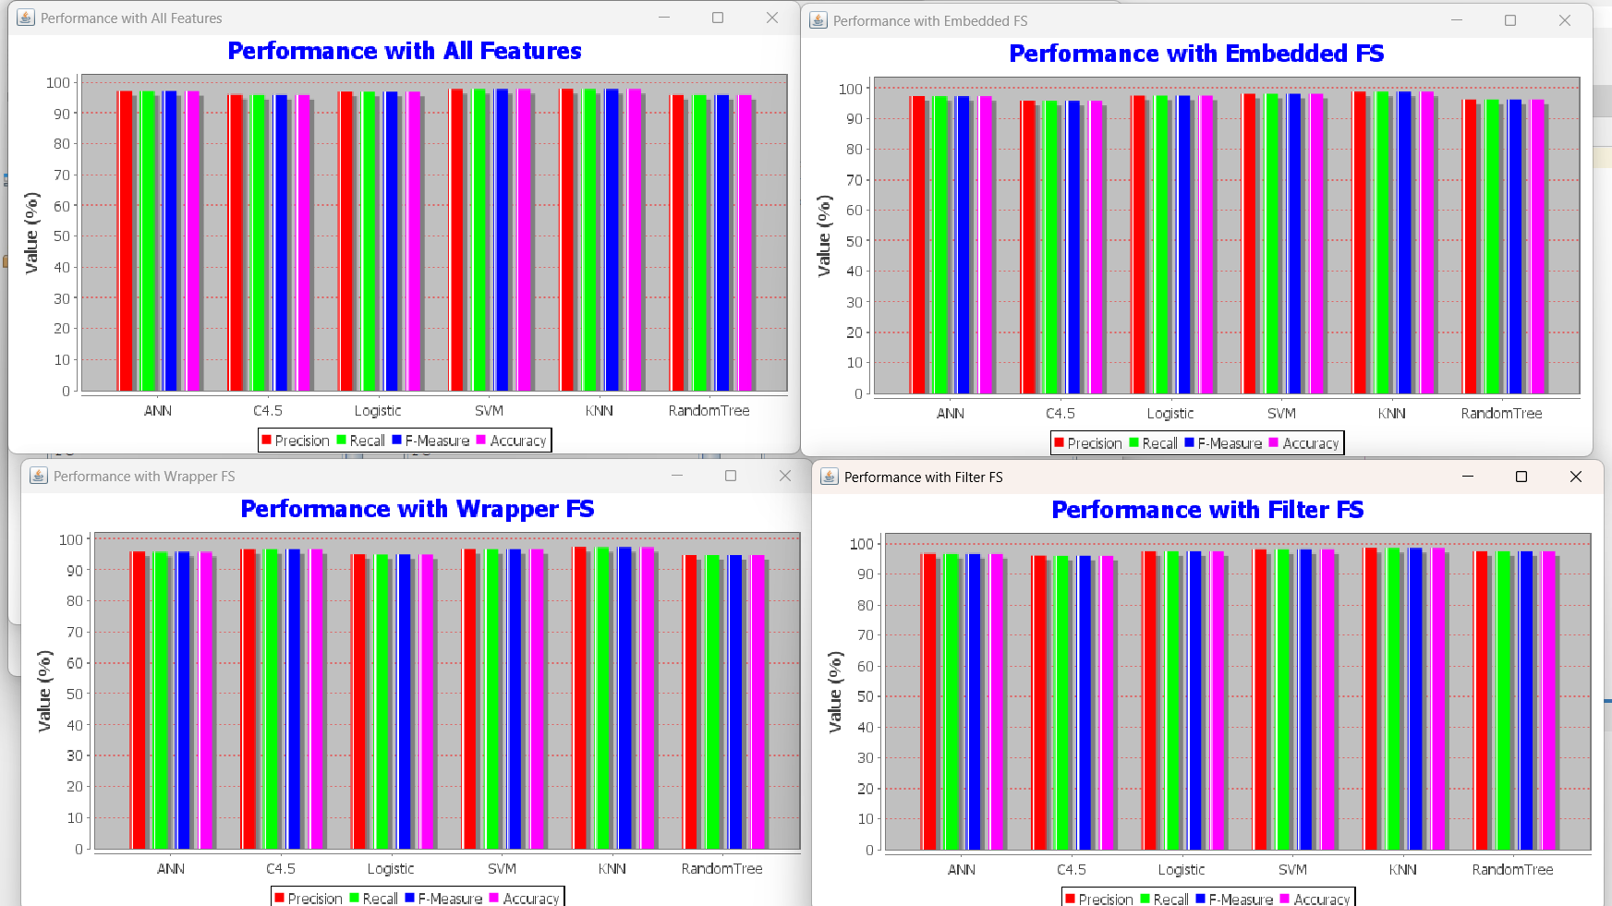
RESULT

Slide 20
EXPECTED OUTCOMES
With All Features (Baseline Accuracy):
ANN → ~96%
Random Tree → ~95%
SVM → ~95%
C4.5 → ~94%
KNN → ~93%
Logistic → ~91%
Key Findings:
Feature selection improved accuracy by +2% to +4%
ANN + Embedded FS = Best performing combination
Bar charts generated to visually compare all algorithms
With Embedded Feature Selection (Best Results):
ANN → 98–99%
Random Tree → ~97–98%
SVM → ~97%
C4.5 → ~96%
KNN → ~95%
Logistic → ~93%

Slide 21
CONCLUSION
Successfully built a CKD Prediction System using Java, Weka, and Java Swing
Applied 3 Feature Selection methods — Filter, Wrapper, Embedded — all successfully reduced irrelevant features
Tested 6 Classification Algorithms using 10-Fold Cross Validation for fair and unbiased evaluation
ANN with Embedded Feature Selection achieved the highest accuracy of ~98–99%
Feature selection consistently improved accuracy by +2% to +4% across all algorithms
The system provides a fast, automated, and accurate way to detect CKD — enabling early diagnosis and treatment
Visual bar charts make it easy for doctors and researchers to compare algorithm performance at a glance

Slide 22
REFERENCES
Jiongming Qin, Lin Chen, Yuhua Liu, Chuanjun Liu, Changhao Feng, and Bin Chen, “A Machine Learning Methodology for Diagnosing Chronic Kidney Disease,”IEEE Access, 2019.
https://ieeexplore.ieee.org/document/8893707
Yawen Zhao et al., “A Chronic Kidney Disease Diagnostic Model Based on an Interpretable Deep Belief Rule Base,”IEEE Access, 2023.
https://ieeexplore.ieee.org/document/10119976
Linta Antony et al.,“A Comprehensive Unsupervised Framework for Chronic Kidney Disease Prediction,”IEEE Access, 2021. https://ieeexplore.ieee.org/document/9446468
P. Chittora, et al.,“Prediction of Chronic Kidney Disease – A Machine Learning Perspective,”IEEE Access, vol. 9, pp. 17312–17334, 2021.
https://ieeexplore.ieee.org/document/9442140
Huda (2025),“Achieved High Accuracy with Transparent Predictions for Chronic Kidney Disease,”Journal Name (pending IEEE Access), 2025.
https://doaj.org/article/246b6b1e42004ca48b204484872cc6bf
Yawen Z. et al. (2022),“Chronic Kidney Disease Diagnostic Model Based on Interpretable Deep Belief Rule Base,”DOAJ / IEEE Access Article, 2022.
https://doaj.org/article/246b6b1e42004ca48b204484872cc6bf

Slide 23
REFERENCES
Vijendra Singh, V. K. Asari, R. Rajkumar Rajasekaran,“A Deep Neural Network for Early Detection and Prediction of Chronic Kidney Disease,” Diagnostics, vol. 12, no. 1, 2022.
https://www.mdpi.com/2075-4418/12/1/116
E. Alonso, U. Irusta, E. Aramendi, M. R. Daya, A Machine Learning Framework for Pulse Detection during Out-of-Hospital Cardiac Arrest, IEEE Access, 2020 — pulse detection using ECG & TI signals.
IEEE paper on pulse detection 2020
Elola, E. Aramendi, U. Irusta et al., Deep Neural Networks for ECG-Based Pulse Detection during Out-of-Hospital Cardiac Arrest, Entropy (Basel), 2019 — DNN architectures for pulse vs PEA classification.
https://pmc.ncbi.nlm.nih.gov/articles/PMC7514786/
Jiapu Pan and W. J. Tompkins, A Real-Time QRS Detection Algorithm, IEEE Transactions on Biomedical Engineering, 1985 — foundational ECG feature extraction method (used in many ML ECG studies). https://ieeexplore.ieee.org/document/4122029
Detection of Cardiac Arrhythmia using Machine Learning, IEEE Xplore Conference Publication — ML classification of ECG rhythms (relevant to OHCA rhythm analysis).
https://ieeexplore.ieee.org/document/10425867

